Slide 1
Sampling Distributions & Point Estimation of Parameters

Slide 2
LO
Discuss sampling distributions and use the Central Limit Theorem to analyze sampling distribution of the means
Discuss sampling distributions; find the point estimation of a parameter.
Apply Central Limit Theorem to calculate probabilities regarding the sampling distribution of the means.

Slide 3
Introduction
Statistical techniques
Population
Make decisions
Draw conclusions about population
Sample
Sample
Statistical inference

Slide 4
Statistical inference
Statistical inference
Parameter estimation
Hypothesis testing

Slide 5
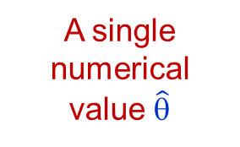

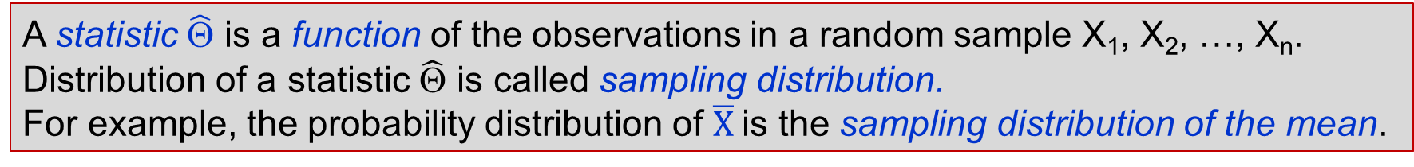
Point estimate
A statistic $\hat{\text{Θ}}$
(estimator)
Population
having parameters θ
A single numerical value $\hat{\text{θ}}$
Sample
Sample
A statistic $\hat{\text{Θ}}$ is a function of the observations in a random sample X₁, X₂, …, X_{n}.
Distribution of a statistic $\hat{\text{Θ}}$ is called sampling distribution.
For example, the probability distribution of $\overline{X}$is the sampling distribution of the mean.

Slide 6
(Point) Estimation problems
Mean
Estimate
μ
σ²
p₁ – p₂
p
μ₁- μ₂
Proportion
Variance
Difference between two means
Difference between two proportions

Slide 7
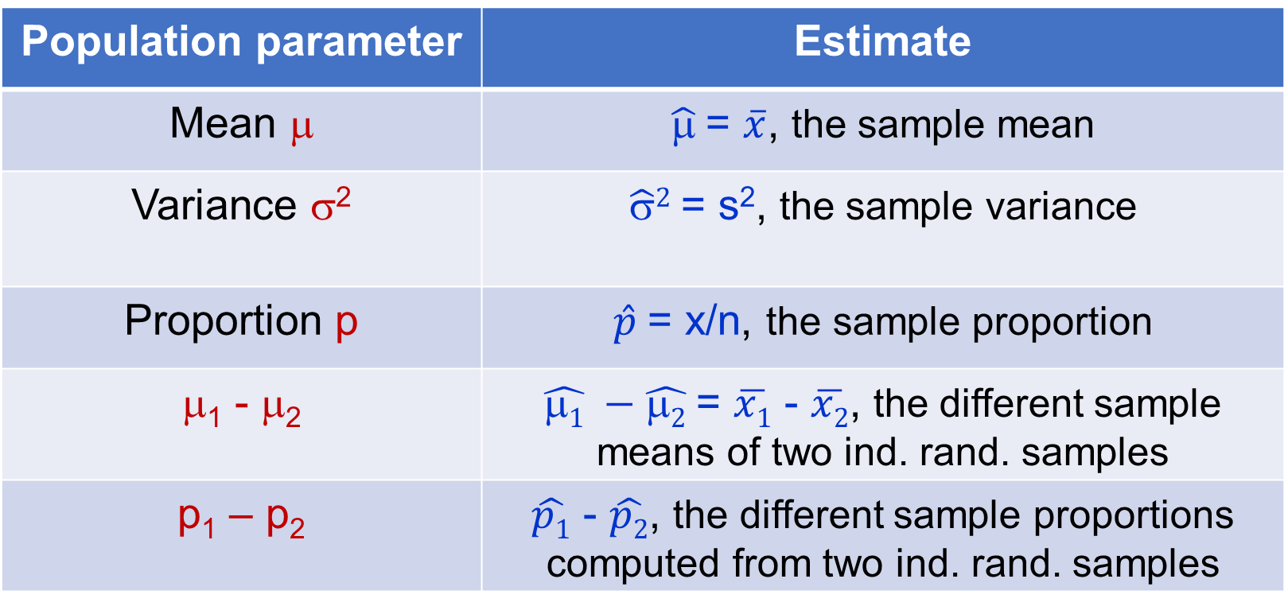
Reasonable estimates
Population parameter | Estimate
Mean μ | $\hat{μ}$= $\overline{x}$, the sample mean
Variance σ² | $\hat{\text{σ}}2$= s², the sample variance
Proportion p | $\hat{p}$= x/n, the sample proportion
μ₁ - μ₂ | $\hat{μ1} −\hat{μ2}$= $\overline{x1}$ - $\overline{x2}$, the different sample means of two ind. rand. samples
p₁ – p₂ | $\hat{p1}$ - $\hat{p2}$, the different sample proportions computed from two ind. rand. samples

Slide 8
Example
Pond 1 = population 1
Pond 2 = population 2























Sample S1
Weight: 1.2, 3.0, 2.3, 1.0; 1.9; 2.1; 1.4; 2.2; 0.7; 1.3; 0.5; 0.8; 2.3; 3.3; 4.1; 3.5; 2.7; 1.3; 3.0; 1.4
Sample S2
Weight: 1.0, 2.3, 1.3; 1.5; 0.3; 1.6; 2.3; 2.6; 3.3; 4.2; 0.8; 2.8; 3.7; 0.5; 4.1; 3.3; 2.1; 3.6; 1.8; 2.1
1) Estimated average weight, variance, standard deviation in each pond. 2) Compare the weight average, variance, standard deviation of the number of fish in two ponds.

Slide 9
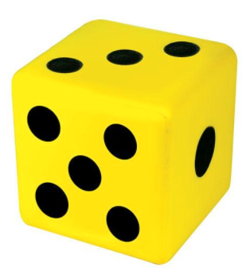
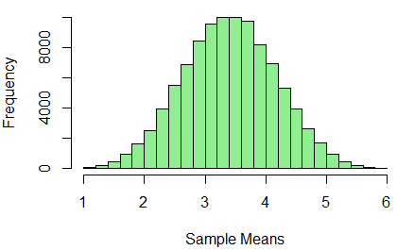
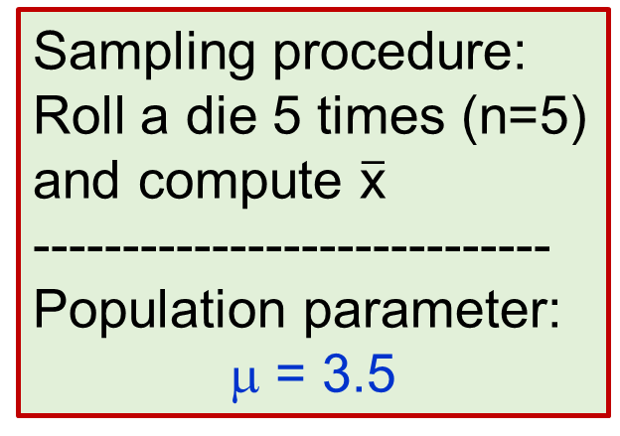
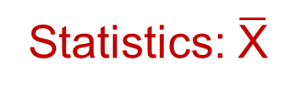
Sampling Distributions The Central Limit Theorem
Mean: 3.49922
Statistics: $\overline{\text{X}}$
Sampling procedure:
Roll a die 5 times (n=5)
and compute $\overline{\text{x}}$
-----------------------------
Population parameter:
μ = 3.5
Sample 1
Measure of Center
4.2
3.6
4.8
•
•
•
2.2
Sample 2
Sample 3
Distribution
Sample 10⁵
Specific results from 100,000 trials:
The population mean is 3.5; the mean of the 100,000 trials is 3.49922. Notice the distribution is “normal.”
Notes:
# Use R
set.seed(1234)
dice_mean<-function(ntimes = 5){
return(mean(sample(1:6,ntimes,rep=T)))
}
N <- 100000
dice <- replicate(N, dice_mean())
head(dice)
mean(dice)
hist(dice,xlab="Sample Means",col=“grey")

Slide 10
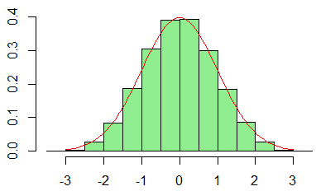
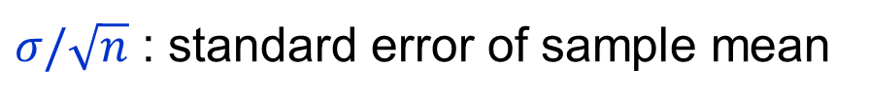
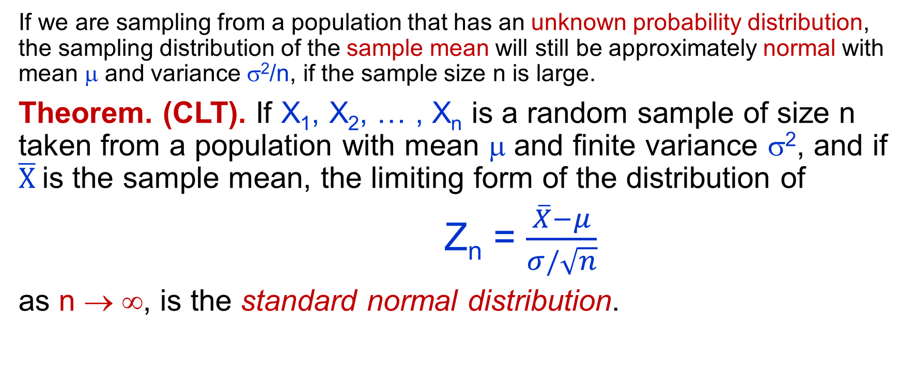
Sampling Distributions The Central Limit Theorem
If we are sampling from a population that has an unknown probability distribution, the sampling distribution of the sample mean will still be approximately normal with mean μ and variance σ²/n, if the sample size n is large.
Theorem. (CLT). If X₁, X₂, … , X_{n} is a random sample of size n taken from a population with mean μ and finite variance σ², and if $\overline{X}$is the sample mean, the limiting form of the distribution of
Z_{n} = $\frac{\overline{X}−μ}{σ/\sqrt{n}}$
as n → ∞, is the standard normal distribution.
$σ/\sqrt{n}$ : standard error of sample mean
Notes:
set.seed(1234)
dice_mean<-function(ntimes = 5){
return(mean(sample(1:6,ntimes,rep=T)))
}
N <- 100000
dice <- replicate(N, dice_mean())
mean(dice)
dice<-(dice-3.5)/(1.707/sqrt(5))
hist(dice,xlab="Sample Means",col='light green',prob=T)
curve(dnorm(x),-3,3,col='red',add=T)

Slide 11
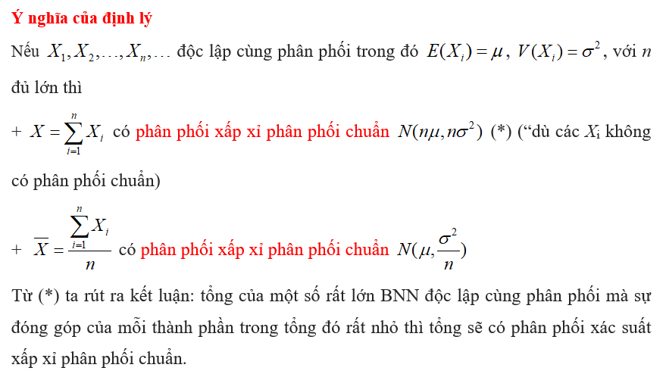

Slide 12
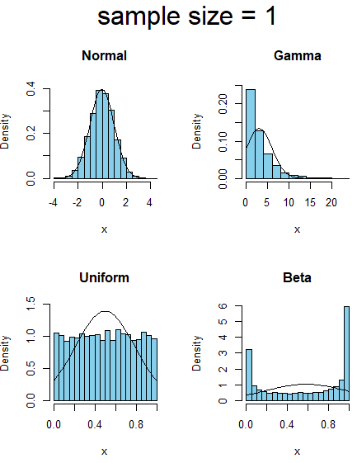
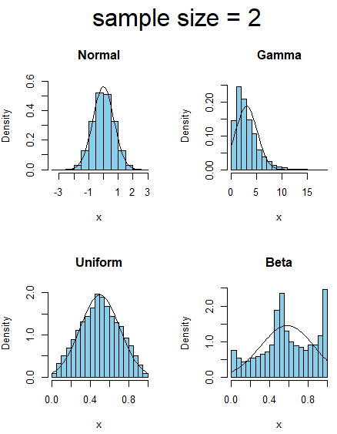
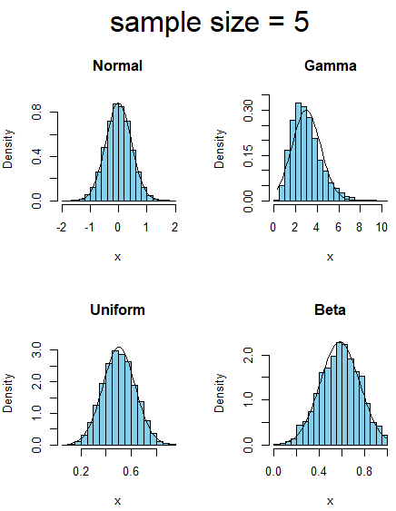
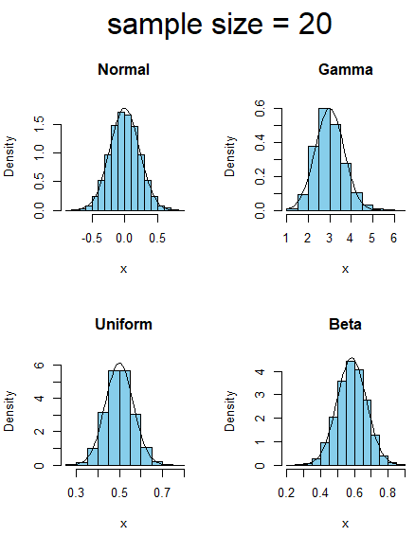
CLT – different sample size
Sampling distribution tends to standard normal distribution as sample size gets larger

Slide 13
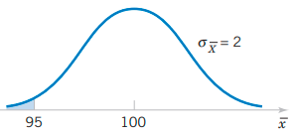
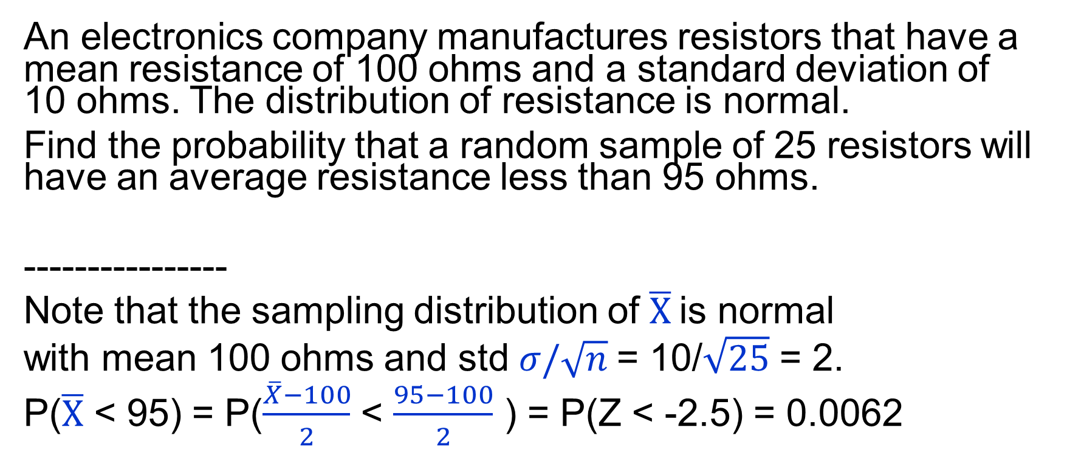
CLT - Example
An electronics company manufactures resistors that have a mean resistance of 100 ohms and a standard deviation of 10 ohms. The distribution of resistance is normal.
Find the probability that a random sample of 25 resistors will have an average resistance less than 95 ohms.
----------------
Note that the sampling distribution of $\overline{X}$is normal
with mean 100 ohms and std $σ/\sqrt{n}$= 10/$\sqrt{25}$ = 2.
P($\overline{X}$ < 95) = P($\frac{\overline{X}−100}{2}$ < $\frac{95−100}{2}$ ) = P(Z < -2.5) = 0.0062

Slide 14
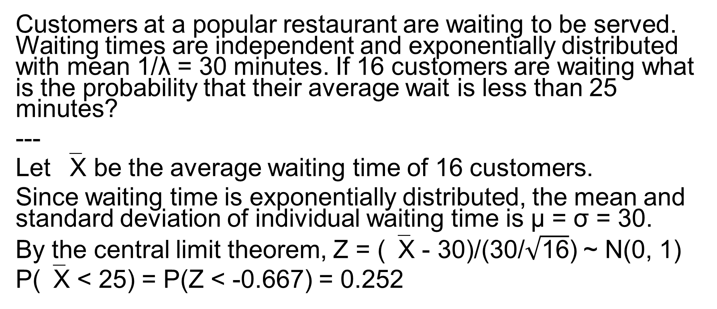
CLT – Ex2
Customers at a popular restaurant are waiting to be served. Waiting times are independent and exponentially distributed with mean 1/λ = 30 minutes. If 16 customers are waiting what is the probability that their average wait is less than 25 minutes?
---
Let ‾X be the average waiting time of 16 customers.
Since waiting time is exponentially distributed, the mean and standard deviation of individual waiting time is μ = σ = 30.
By the central limit theorem, Z = (‾X - 30)/(30/$\sqrt{\text{16}}$) ~ N(0, 1)
P(‾X < 25) = P(Z < -0.667) = 0.252

Slide 15
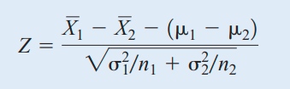
Approximate Sampling Distribution of a Difference in Sample Means
N(0, 1)
Ex. The effective life of a component used in a jet-turbine aircraft engine is a random variable with mean 5000 hours and standard deviation 40 hours. The distribution of effective life is fairly close to a normal distribution. The engine manufacturer introduces an improvement into the manufacturing process for this component that increases the mean life to 5050 hours and decreases the standard deviation to 30 hours. Suppose that a random sample of n₁ = 16 components is selected from the “old” process and a random sample of n₂ = 25 components is selected from the “improved” process.
What is the probability that the difference in the two sample means is at least 25 hours? Assume that the old and improved processes can be regarded as independent populations.

Slide 16
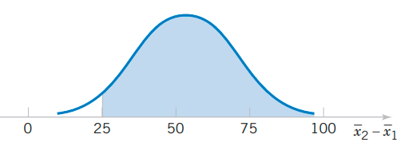


Example (cont.)
We have
$\overline{X}1$ ~ N(μ₁, $σ12/n1$ ) = N(5000, 100)
$\overline{X}2$ ~ N(μ₂, $σ22/n2$ ) = N(5050, 36)
➔ $\overline{X}2$ - $\overline{X}1$ ~ N(μ₁ - μ₂, $σ12/$n₁ + $σ22/$n₂) = N(50, 136)

Slide 17
Like hurricanes and earthquakes, geomagnetic storms are natural hazards with possible severe impact on the Earth. Severe storms can cause communication and utility breakdowns, leading to possible blackouts. The National Oceanic and Atmospheric Administration beams electron and proton flux data in various energy ranges to various stations on the Earth to help forecast possible disturbances. The following are 25 readings of proton flux in the 47-68 kEV range (units are in p / (cm2-sec-sterMeV)) on the evening of December 28, 2011: 2310 2320 2010 10800 2190 3360 5640 2540 3360 11800 2010 3430 10600 7370 2160 3200 2020 2850 3500 10200 8550 9500 2260 7730 2250
a/ Find a point estimate of the mean proton flux in this time period.
b/ Find a point estimate of the standard deviation of the proton flux in this time period.
c/ Find an estimate of the standard error of the estimate in part a/.

Slide 18
Exercises
(3x + 13) mod 21
(5x + 15) mod 21
(7x + 17) mod 21

Slide 19
Exercises
(7-14). A consumer electronics company is comparing the brightness of two different types of picture tubes for use in its television sets. Tube type A has mean brightness of 100 and standard deviation of 16, and tube type B has unknown mean brightness, but the standard deviation is assumed to be identical to that for type A. A random sample of n = 25 tubes of each type is selected, and‾X_{B} -‾X_{A} is computed. If μ_{B} equals or exceeds μ_{A}, the manufacturer would like to adopt type B for use. The observed difference is‾x_{B} -‾x_{A} = 3.5. What decision would you make, and why?

Slide 20
Exercise
The waiting time on the cashier’s line at Passio is exponentially distributed with mean 5 minutes. Use the central limit theorem to find the approximate probability that the average waiting time is more than 4 minutes for a group of 16 people.

Slide 21
Exercise
The local farm packs its tomatoes in crates. Individual tomatoes have mean weight of 10 ounces and standard deviation 3 ounces. Find the probability that a crate of 50 tomatoes weighs between 480 and 510 ounces.

Slide 22
Exercise
The population standard deviation is σ = 9. For a random sample, the standard deviation of the sample mean is 1.5. What is the sample size?

Slide 23
Exercise
It is known that IQ scores have a normal distribution with a mean of 100 and a standard deviation of 15.
A random sample of 36 students is selected. What is the probability that the sample mean IQ score of these 36 students is between 95 and 110?
A random sample of 100 students is selected. What is the probability that the sample mean IQ score of these 100 students is between 95 and 110

Slide 24
Exercise
The amount of time that a ten-year-old boy plays video games in a week is normally distributed with a mean of 10 hours and a standard deviation of 4 hours.
Suppose 9 ten-year-old boys are randomly chosen. What is the probability that the sample mean time for playing video games per week is 8 to 12 hours?
Suppose a boy is considered addicted if he plays video games for more than 16 hours a week. If 12 ten-year-old boys are to be chosen at random, fnd the probability that at least 1 is addicted to video games.

Slide 25
Exercise
Heights of men in America have a normal distribution with a mean of 69.5 inches and a standard deviation of 3 inches. Perform the following calculations.
In a random sample of 20 adult men in the United Sates, fnd P X (687 < 0).
Let X represent the mean height of a random sample of n American adults. Find n if P(68.52 < X < 70.48) 0 = 0.95.
If 100 American men are chosen at random, fnd an approximate probability that at least 25 of them are shorter than 68 inches.

